Slide 1

DBSCAN
Simplifying Complex Data Clustering
Density-Based Spatial Clustering of Applications with Noise

Slide 2

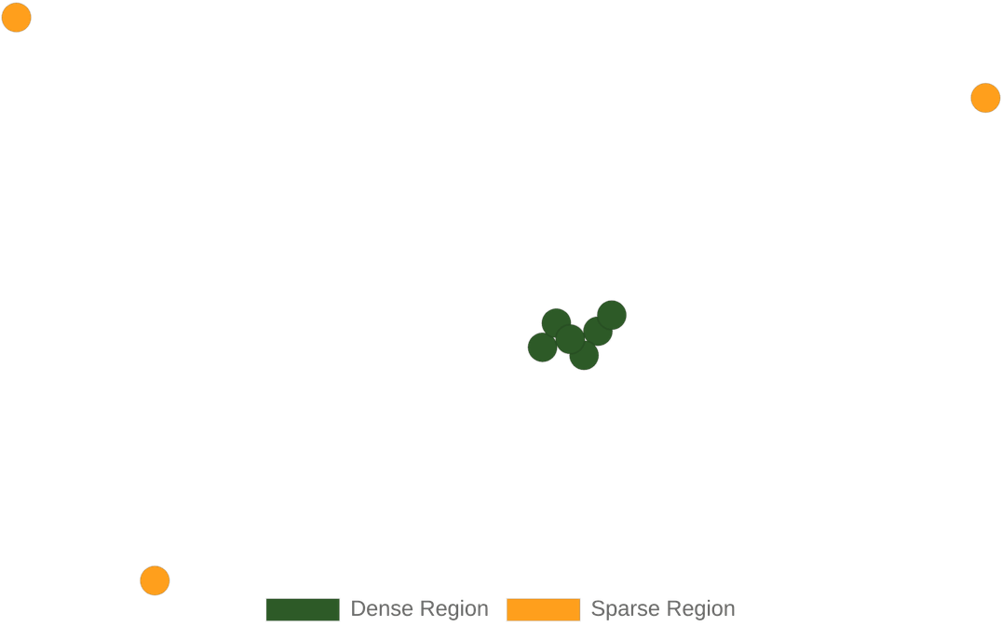
THE CORE CONCEPT: DENSITY
DBSCAN identifies clusters based on how densely data points are packed.
Epsilon (ε): The maximum radius around a point to look for neighbors.
MinPts: The minimum number of points required within Epsilon to form a cluster.

Slide 3
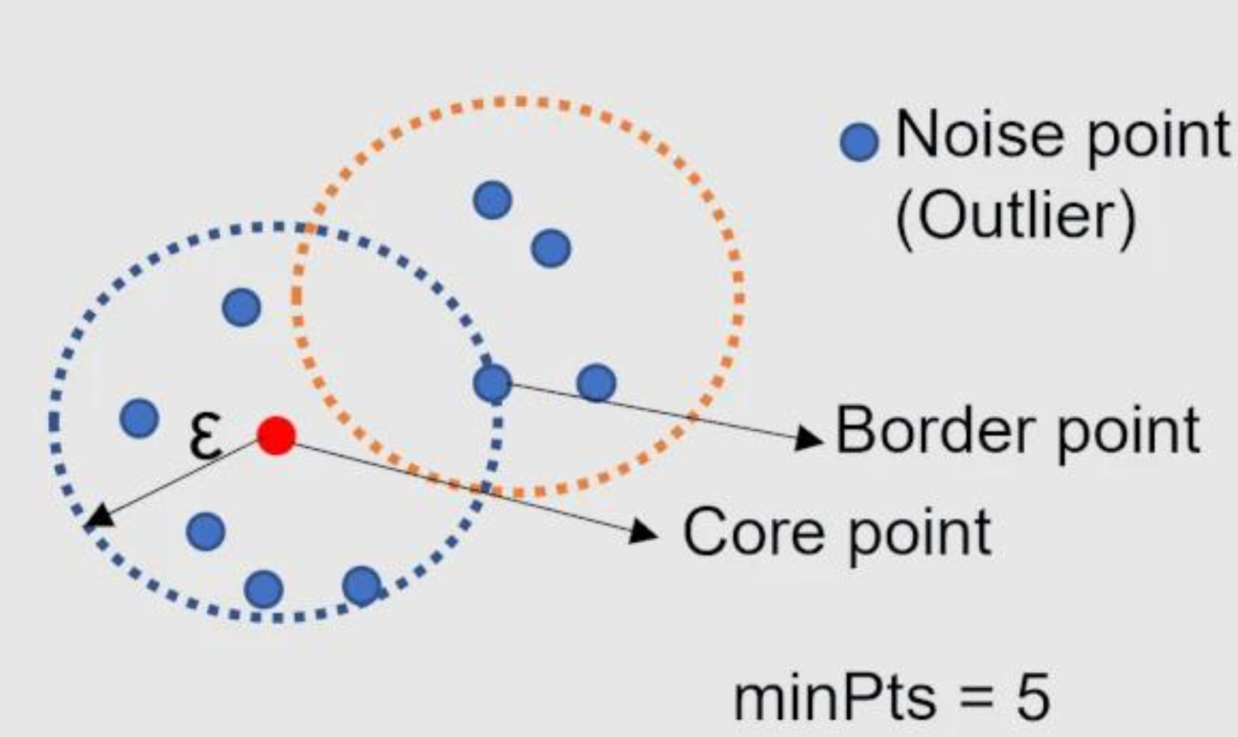



THREE TYPES OF DATA POINTS
https://clustering-visualizer.web.app/dbscan
Border Points
Core Points
Noise Points
A core point has at least MinPts points (including itself) within a distance of eps (ε).
A border point:
Has fewer than MinPts neighbors within ε.
But lies within ε of a core point.
So, it belongs to a cluster but cannot expand the cluster.
Points that are neither Core nor Border. These are identified as outliers or background noise.
If MinPts = 5, then a point is a core point if there are 5 or more points (including itself) within ε distance.

Slide 4

Notes:
https://www.youtube.com/shorts/_iUl81_2BmQ

Slide 5

WHY CHOOSE DBSCAN?
NO PREDEFINED CLUSTERS
HANDLES IRREGULAR SHAPES
Unlike K-Means, you don't need to specify the number of clusters (K) in advance. It discovers them automatically.
It can identify clusters of any shape—circular, elongated, or even nested—where distance-based methods fail.
ROBUST TO OUTLIERS
SCALABLE PERFORMANCE
DBSCAN is naturally resistant to noise. It labels isolated points as "noise" rather than forcing them into a cluster.
Highly efficient for large spatial databases, making it a go-to choice for real-world big data applications.

Slide 6





WHERE IS DBSCAN USED?
ANOMALY DETECTION
SATELLITE IMAGERY
Grouping similar geographical features or urban areas based on pixel density and proximity.
Identifying fraudulent transactions or network intrusions by spotting isolated noise points.
NATURAL SCIENCES
RECOMMENDATION
Clustering stars in astronomy or grouping complex biological data in genetics.
Finding groups of users with similar niche interests without assuming the number of groups.

Slide 7




SUMMARY
Discover patterns without prior assumptions.
Focus on
density
rather than distance to a
center.
Ideal for messy, irregular, and noisy real-world
data.

